Slide 1


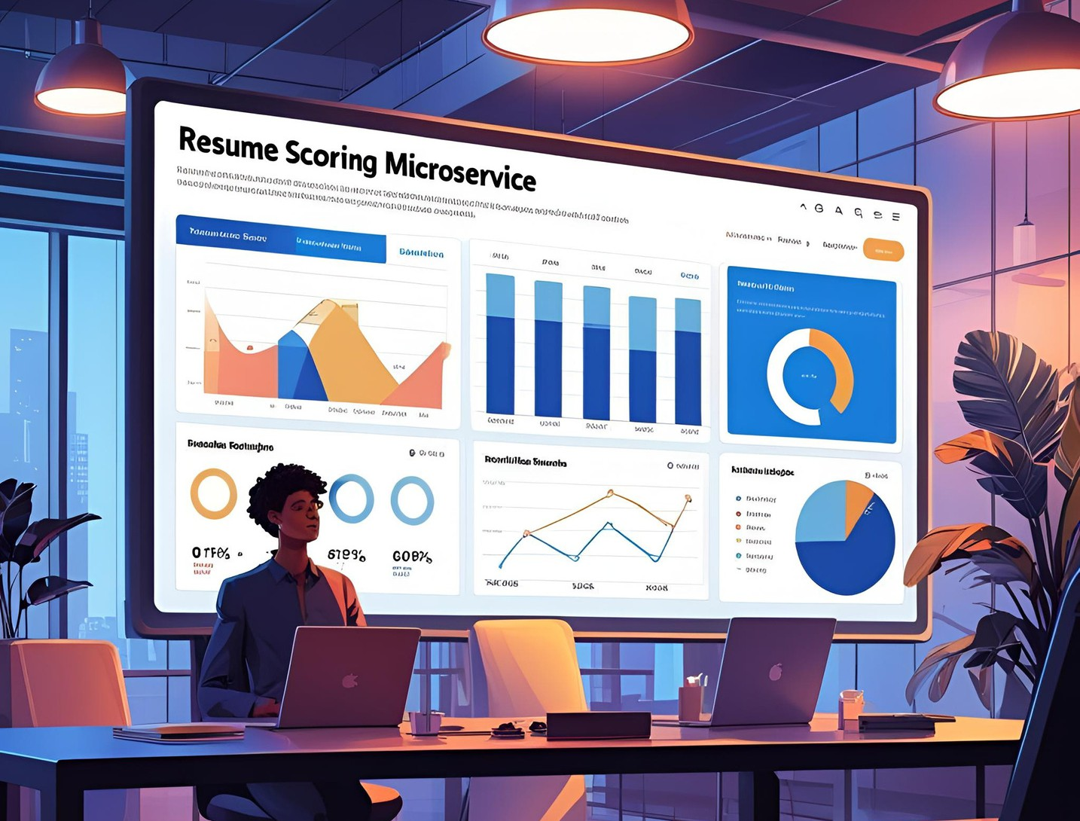





Slide 2






Prepared By
SOURAV MAHAPATRA
TEAM : PARALLAX PIONEERS
souravmahapatra@turtilintern.com
+91 - 94391 70282

Slide 3

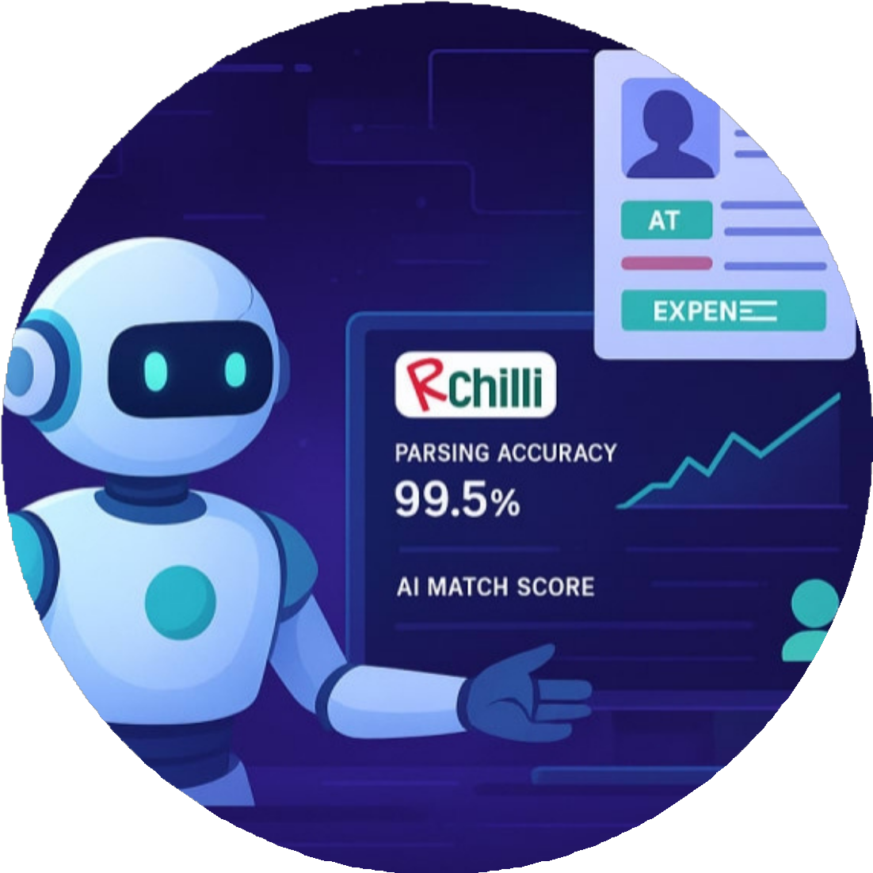



Introduction Objective
Approach Mind Map Demo
Future Scope
Challenges & Solutions Conclusion

Slide 4




INTRODUCTION
What it is: A smart micro service for scoring student resumes against career goals.
How it works: Uses machine learning and NLP to analyze resumes, provide scores, and suggest improvements.
Why it's useful: Helps students prepare effectively for competitive roles and exams.
Key features: High accuracy, configurable, offline-capable, supports multiple goals.
Target audience: Educational institutions, career platforms, students.

Slide 5


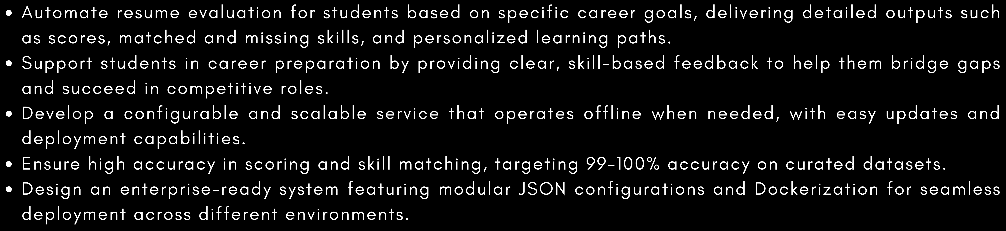





Text preprocessing
Skill Matching
Resume Scoring
RESTful API
Dockerized Deployment

Slide 6
2.Dataset Preparation
1. Modular Project Structure
Separated code into logical
modules: main.py (API),scorer.py
(logic), model/, data/, and tests/.
Created a dataset of 612 resumes (204 per goal).
Labeled resumes as suitable or unsuitable based on required skills.
Sourced skills from job descriptions and GATE ECE syllabus.
Ensured balanced data to avoid bias.

Slide 7

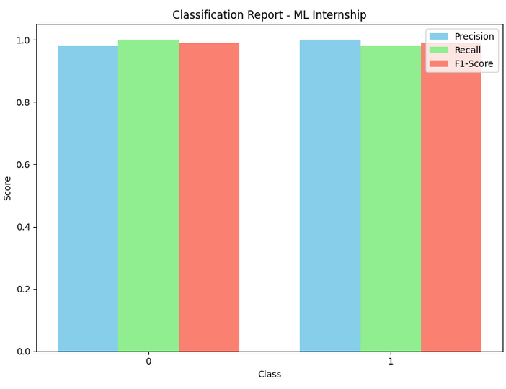
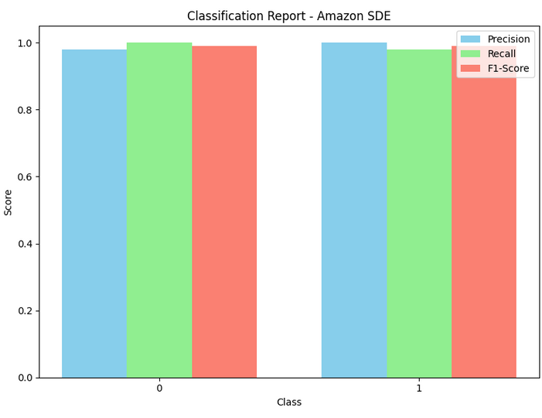
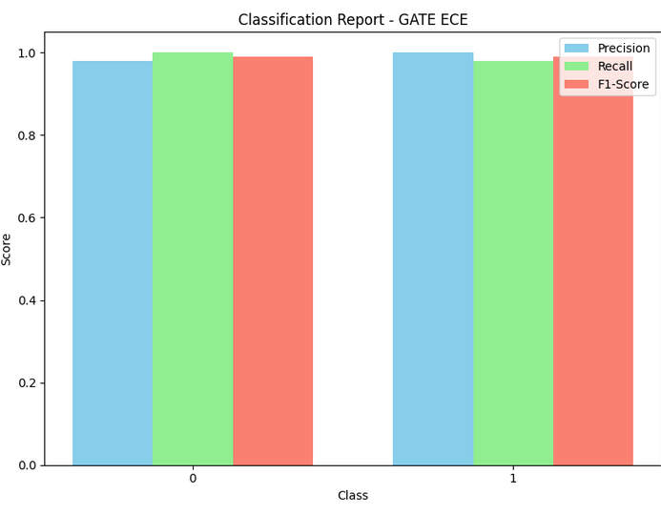

3. Model Selection and Training
Model Used:
Logistic Regression with text analysis (TF-IDF).
Chosen for simplicity, speed, and high accuracy.
Results:
Achieved 99–100% accuracy across all goals. Trained separate models for each career goal.

Slide 8
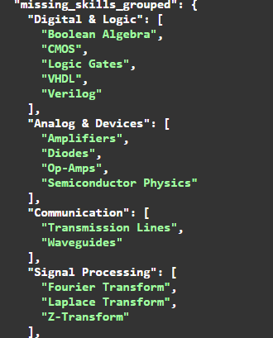
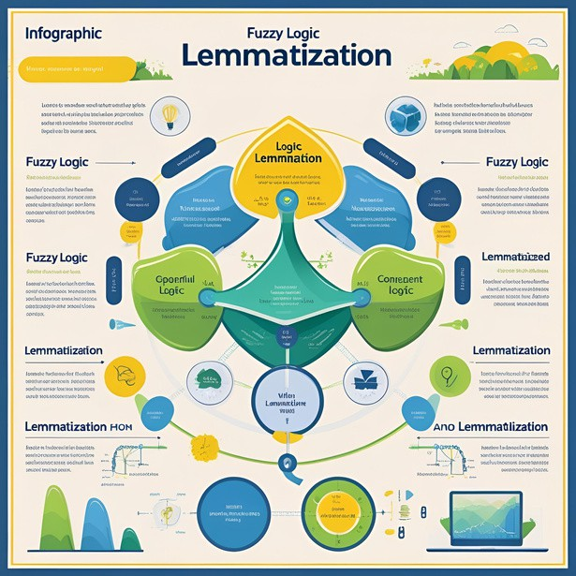

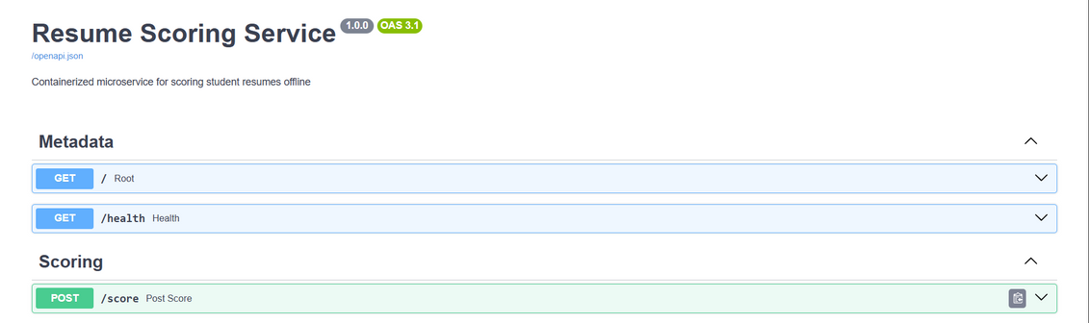
4. Skill Logic
How It Works:
Uses Natural Language Processing (NLP) to identify skills in resumes along with word matching.
Matches skills even with different wordings (e.g.,
“Machine Learning” vs. “ML”) using fuzzy logic and lemmatization.
Groups skills into categories (e.g., Programming,
Electronics).
Suggests learning resources for missing skills.
5. API Development
API Features:
POST /score: Submits a resume for scoring.
GET /health: Checks if the service is running.
GET /version: Provides service details (e.g., version, supported goals).
Why It Matters:
Easy to integrate with job portals or educational platforms.

Slide 9




6 . Configuration
Key Feature:
Uses JSON files to define goals, skills, and settings. Allows easy updates without changing the code.
Benefit:
Flexible and scalable for adding new career goals.
7. Dockerization
What It Means:
Packaged in Docker for easy deployment. Runs offline without external dependencies.
Why Important:
Ensures the service works consistently on any system.

Slide 10

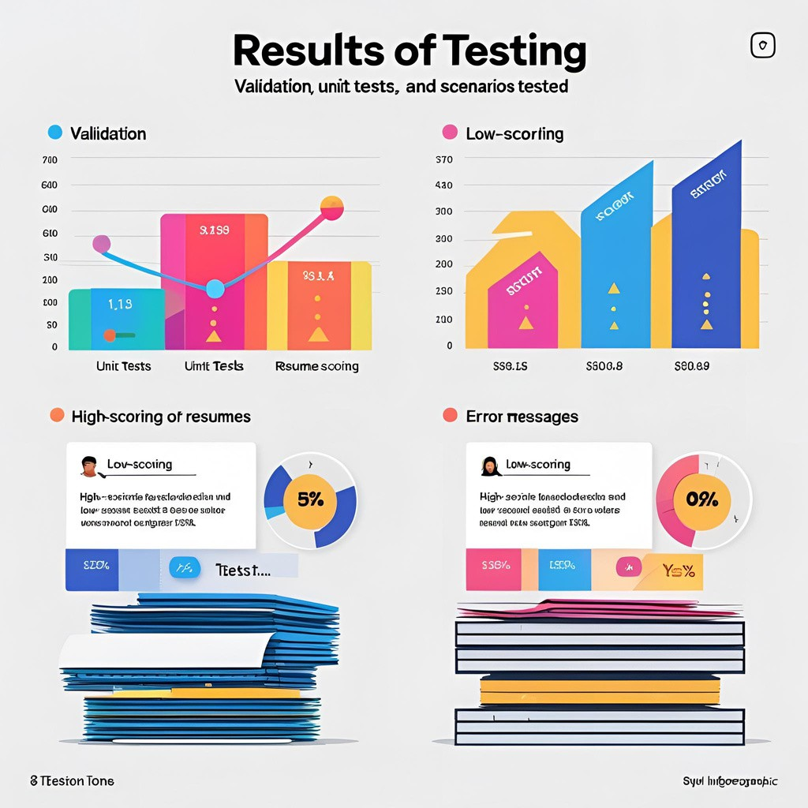

8. Testing - Validation
Scenarios Tested:
High-scoring resumes: Correct scores and skill matches.
Low-scoring resumes: Identifies missing
skills accurately.
Errors: Provides clear error messages (e.g., “Resume text cannot be empty”).
Result:
Over 90% test coverage, ensuring reliability.
Why It Matters:
Ensures the service works in real-world situations.

Slide 11

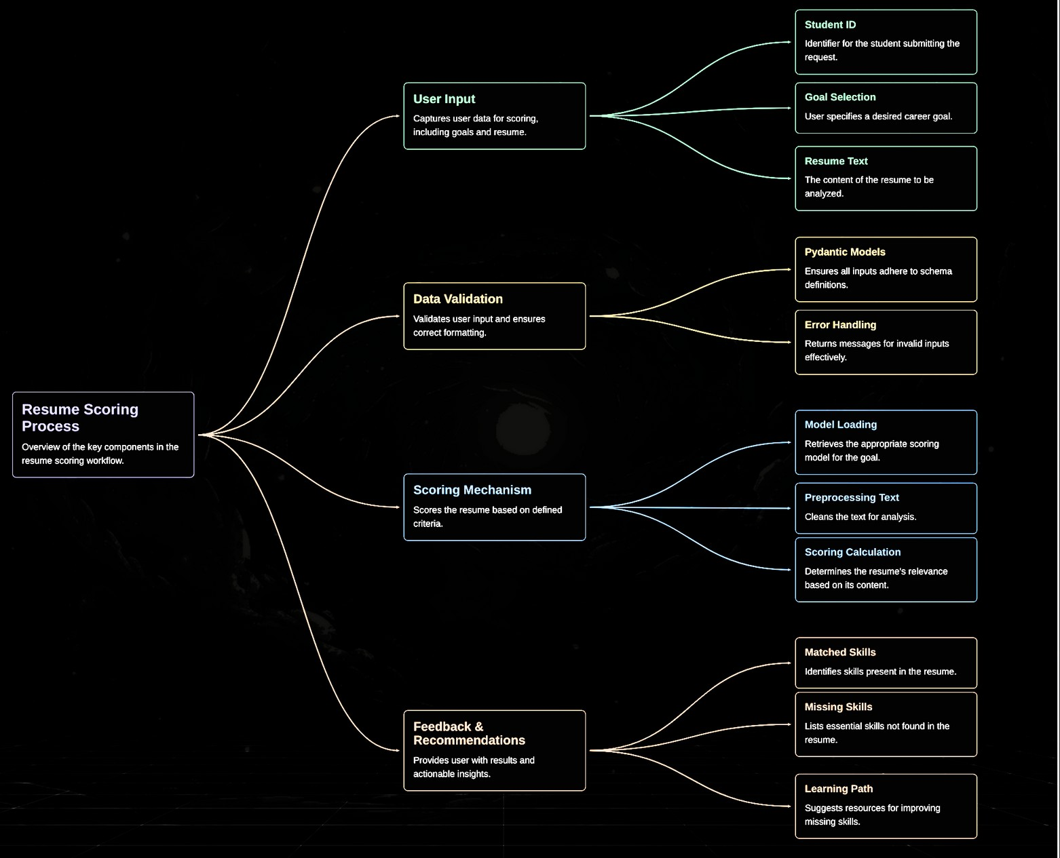




Slide 12

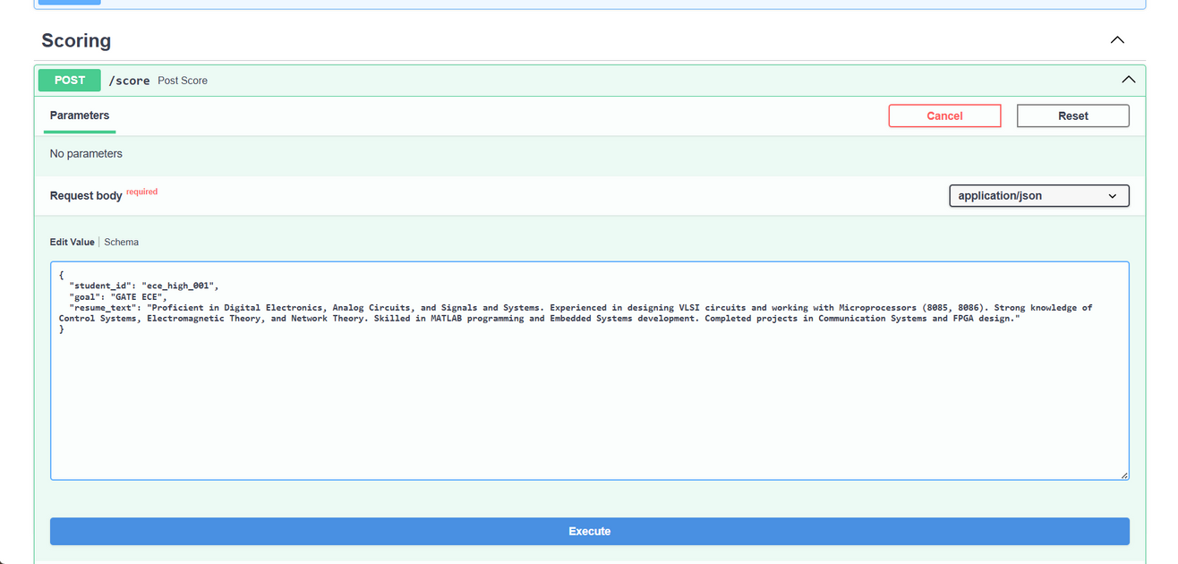


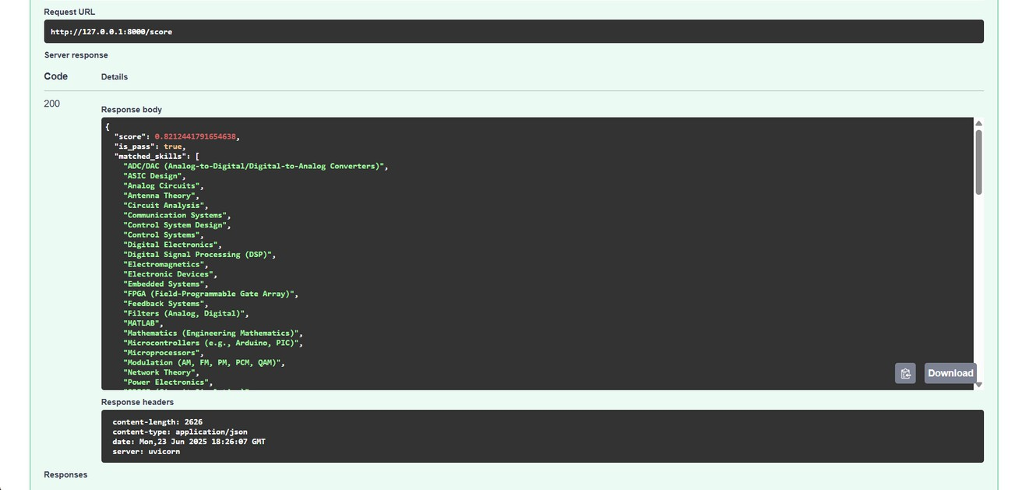

1. Scoring a Resume
How It Works:
Submit a resume with student ID, goal (e.g., GATE ECE), and resume text.
Example Output:
Score: 0.821 (out of 1). Pass: Yes (meets threshold). Matched Skills: Digital MATLAB, FPGA, etc.
Electronics,

Slide 13

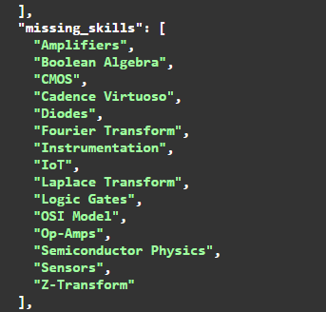

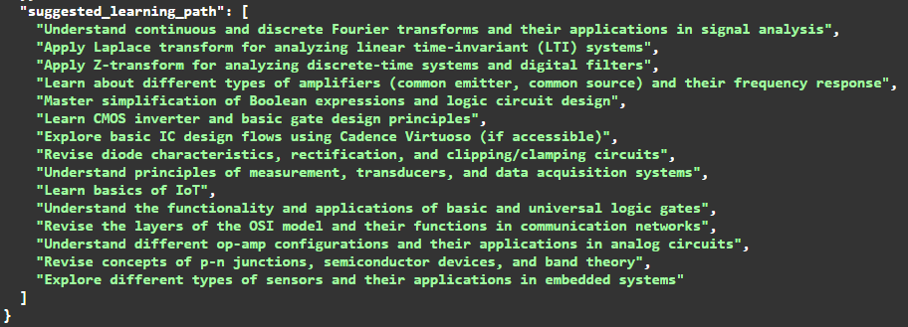

2. Missing Skills and Learning Path
Output Example:
Missing Skills: Fourier Transform, Op-Amps, etc.
Learning Path: Study Fourier transforms, learn op-amp configurations.

Slide 14

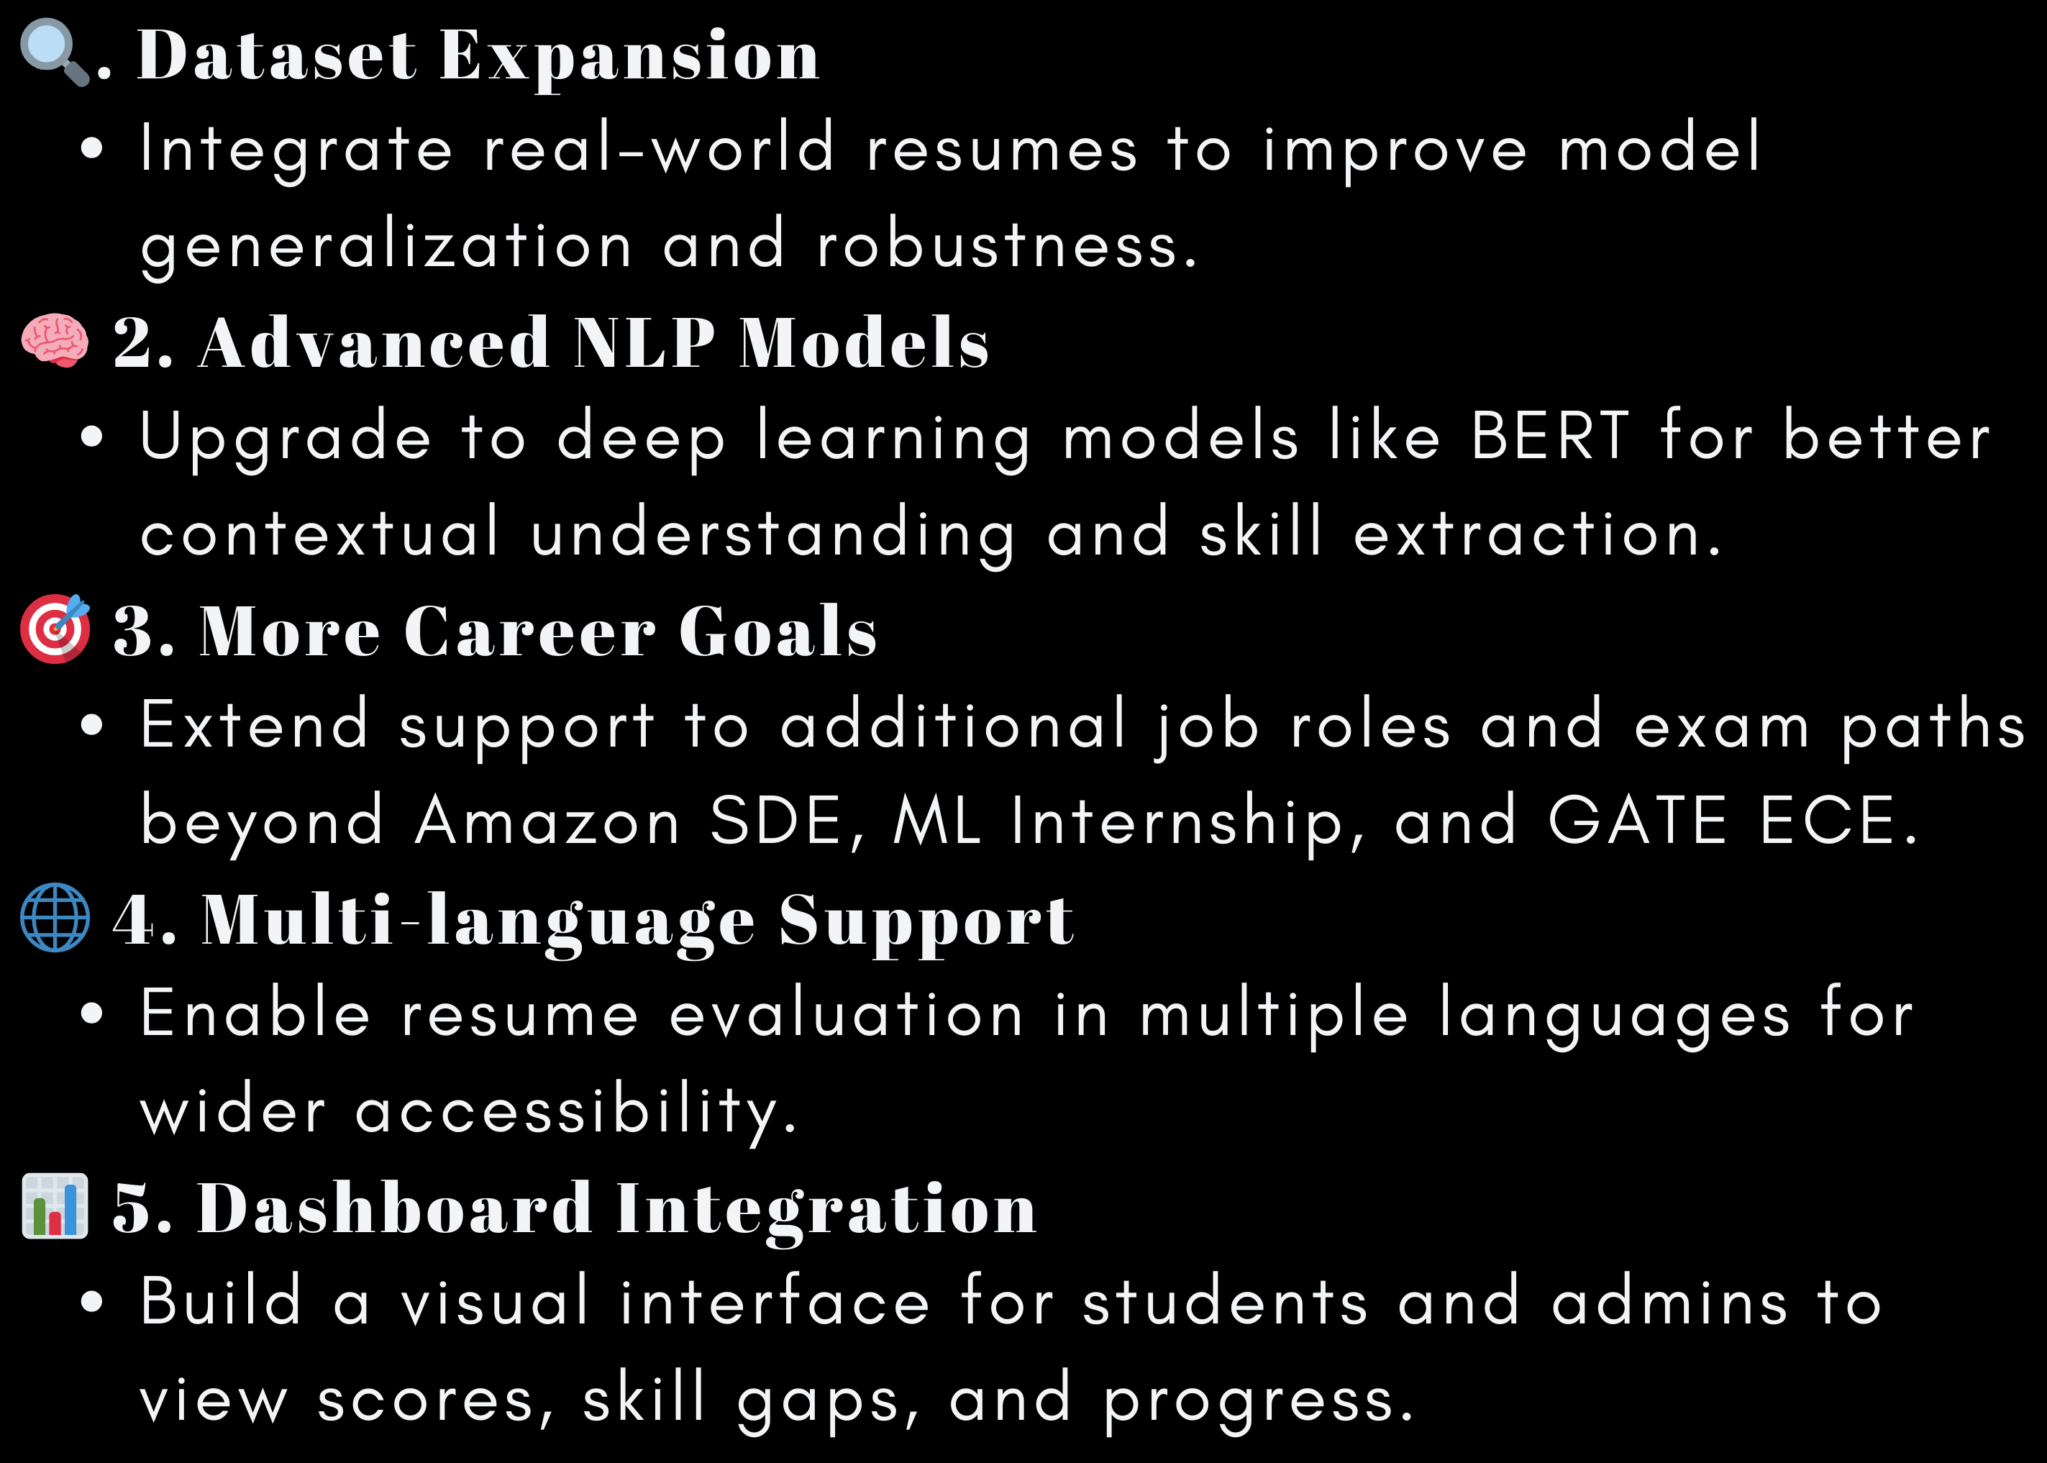

FUTURE SCOPE AND
ENHANCEMENTS
25
20
15
10
5
0
2021
2022
2023
2024
2025

Slide 15





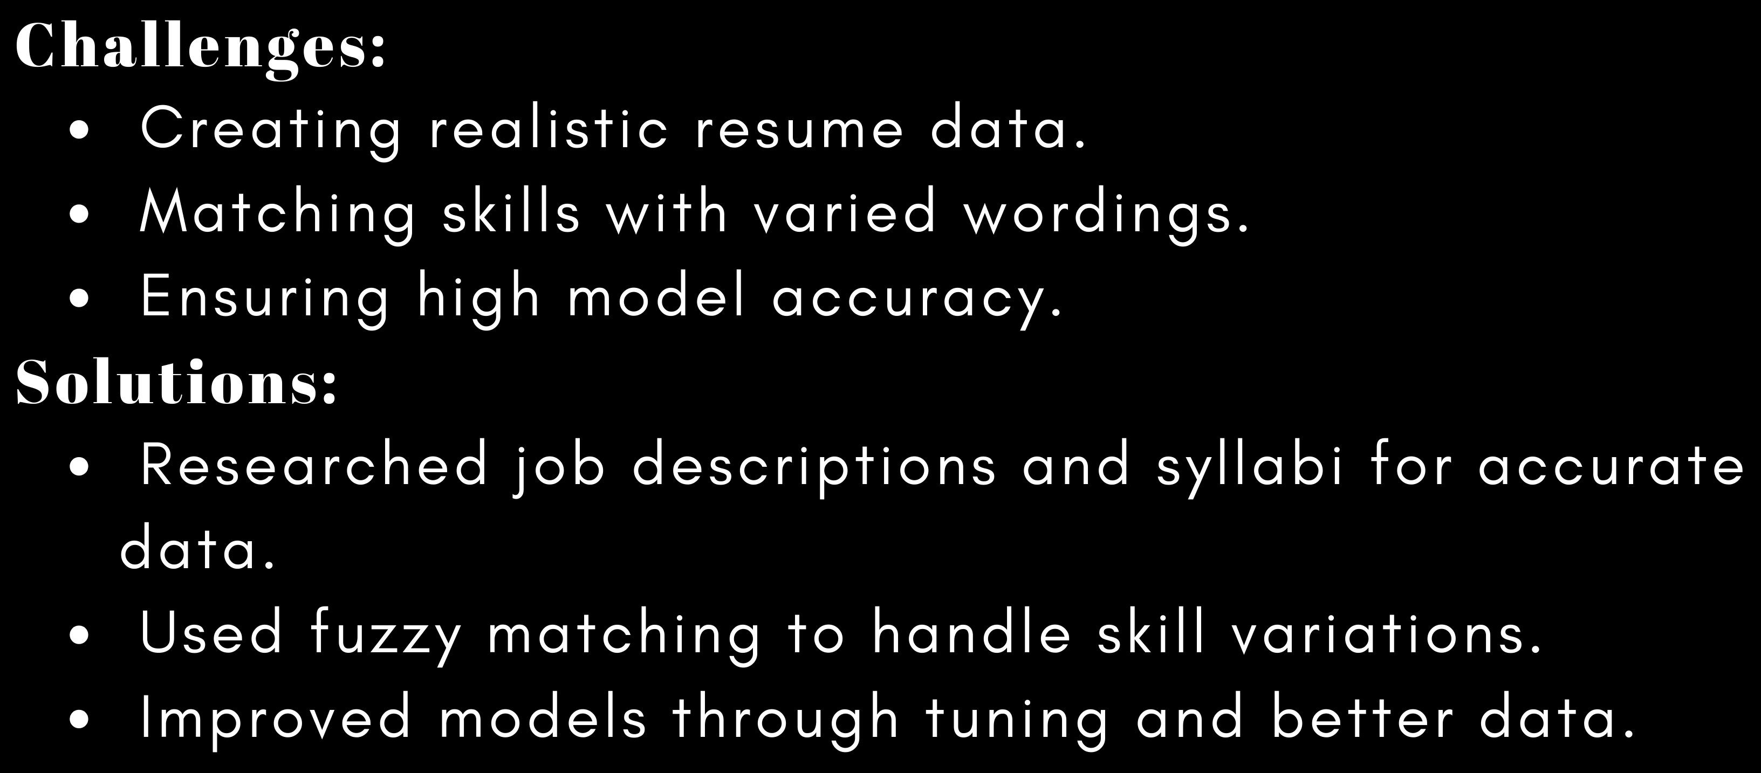




Slide 16




Enhanced Hiring Efficiency
The microservice streamlines resume evaluation,
significantly reducing manual effort and recruitment time.
Objective And Scalable Assessment
Ensures fair, consistent scoring across large volumes of
resumes, adaptable to various job profiles and industries.
Future-Ready Integration
Lays the foundation for intelligent recruitment systems with
potential for integration into larger HR platforms and learning management systems.
Enterprise Standards
Designed with modular code, configurable settings, and robust error
handling.Ensures scalability, easy updates, and reliable performance for enterprise use.

Slide 17
THANK YOU

